Slide 1
Open Elective III OE 781 CE Road Safety Engineering UNIT I ROAD ACCIDENTS

Slide 2
Unit I: Overview
Road Accidents
Causes, scientific investigations and data collection, Analysis of individual accidents to arrive at real causes, Statistical methods of analysis of accident data, Safety performance function: The empirical Bayes method Identification of Hazards road location. Application of computer analysis of accident data. Approaches to Highway Safety

Slide 3
Road traffic safety
Road traffic safety refers to the methods and measures used to prevent road users from being killed or seriously injured.
Typical road users include:
Pedestrians,
Cyclists,
Motorists,
vehicle passengers,
Passengers of on-road public transport.

Slide 4
Road Accident - Terminology
A road accident may cause a loss of life/lives or grievous injury, minor injury or non-injury to road-users.
An accident, which results in death of one or more person, is a fatal accident.
Grievous injury accident is one in which one or more victims suffer serious injury requiring hospitalization.
Minor injury accident is one in which victim(s) does not require hospitalization.

Slide 5
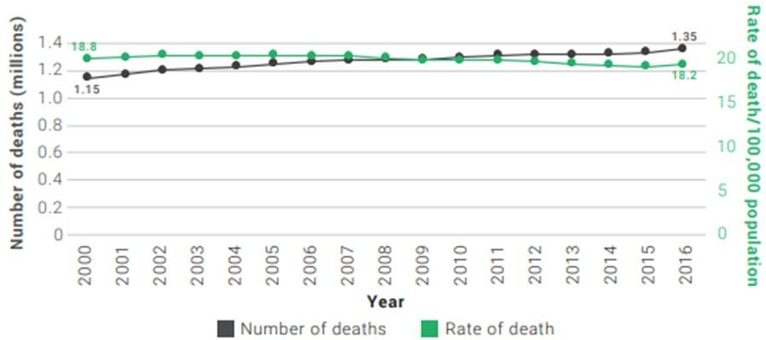
Accidents - Facts (Global)
Each year, 1.35 million people are killed on roadways around the world. (W.H.O. : Global Status Report on Road Safety 2018)
Figure 1: Number and rate of road traffic death per 100000 population: 2000-2016

Slide 6
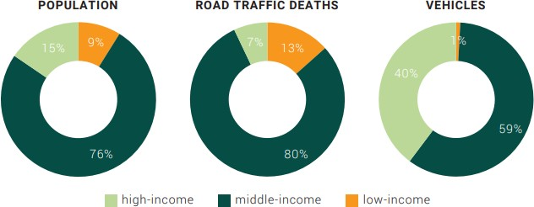
Accidents - Facts (Global)
Low- and middle-income countries only account for 60% of the world’s registered vehicles but more than 90% of the world’s road traffic deaths.
Figure 2: Proportion of population, road traffic deaths and registered vehicles by country income category (world bank report 2017)

Slide 7
Accidents - Facts (Global)
Every day, almost 3,700 people are killed globally in road traffic crashes involving cars, buses, motorcycles, bicycles, trucks, or pedestrians. More than half of those killed are pedestrians, motorcyclists, and cyclists.

Slide 8
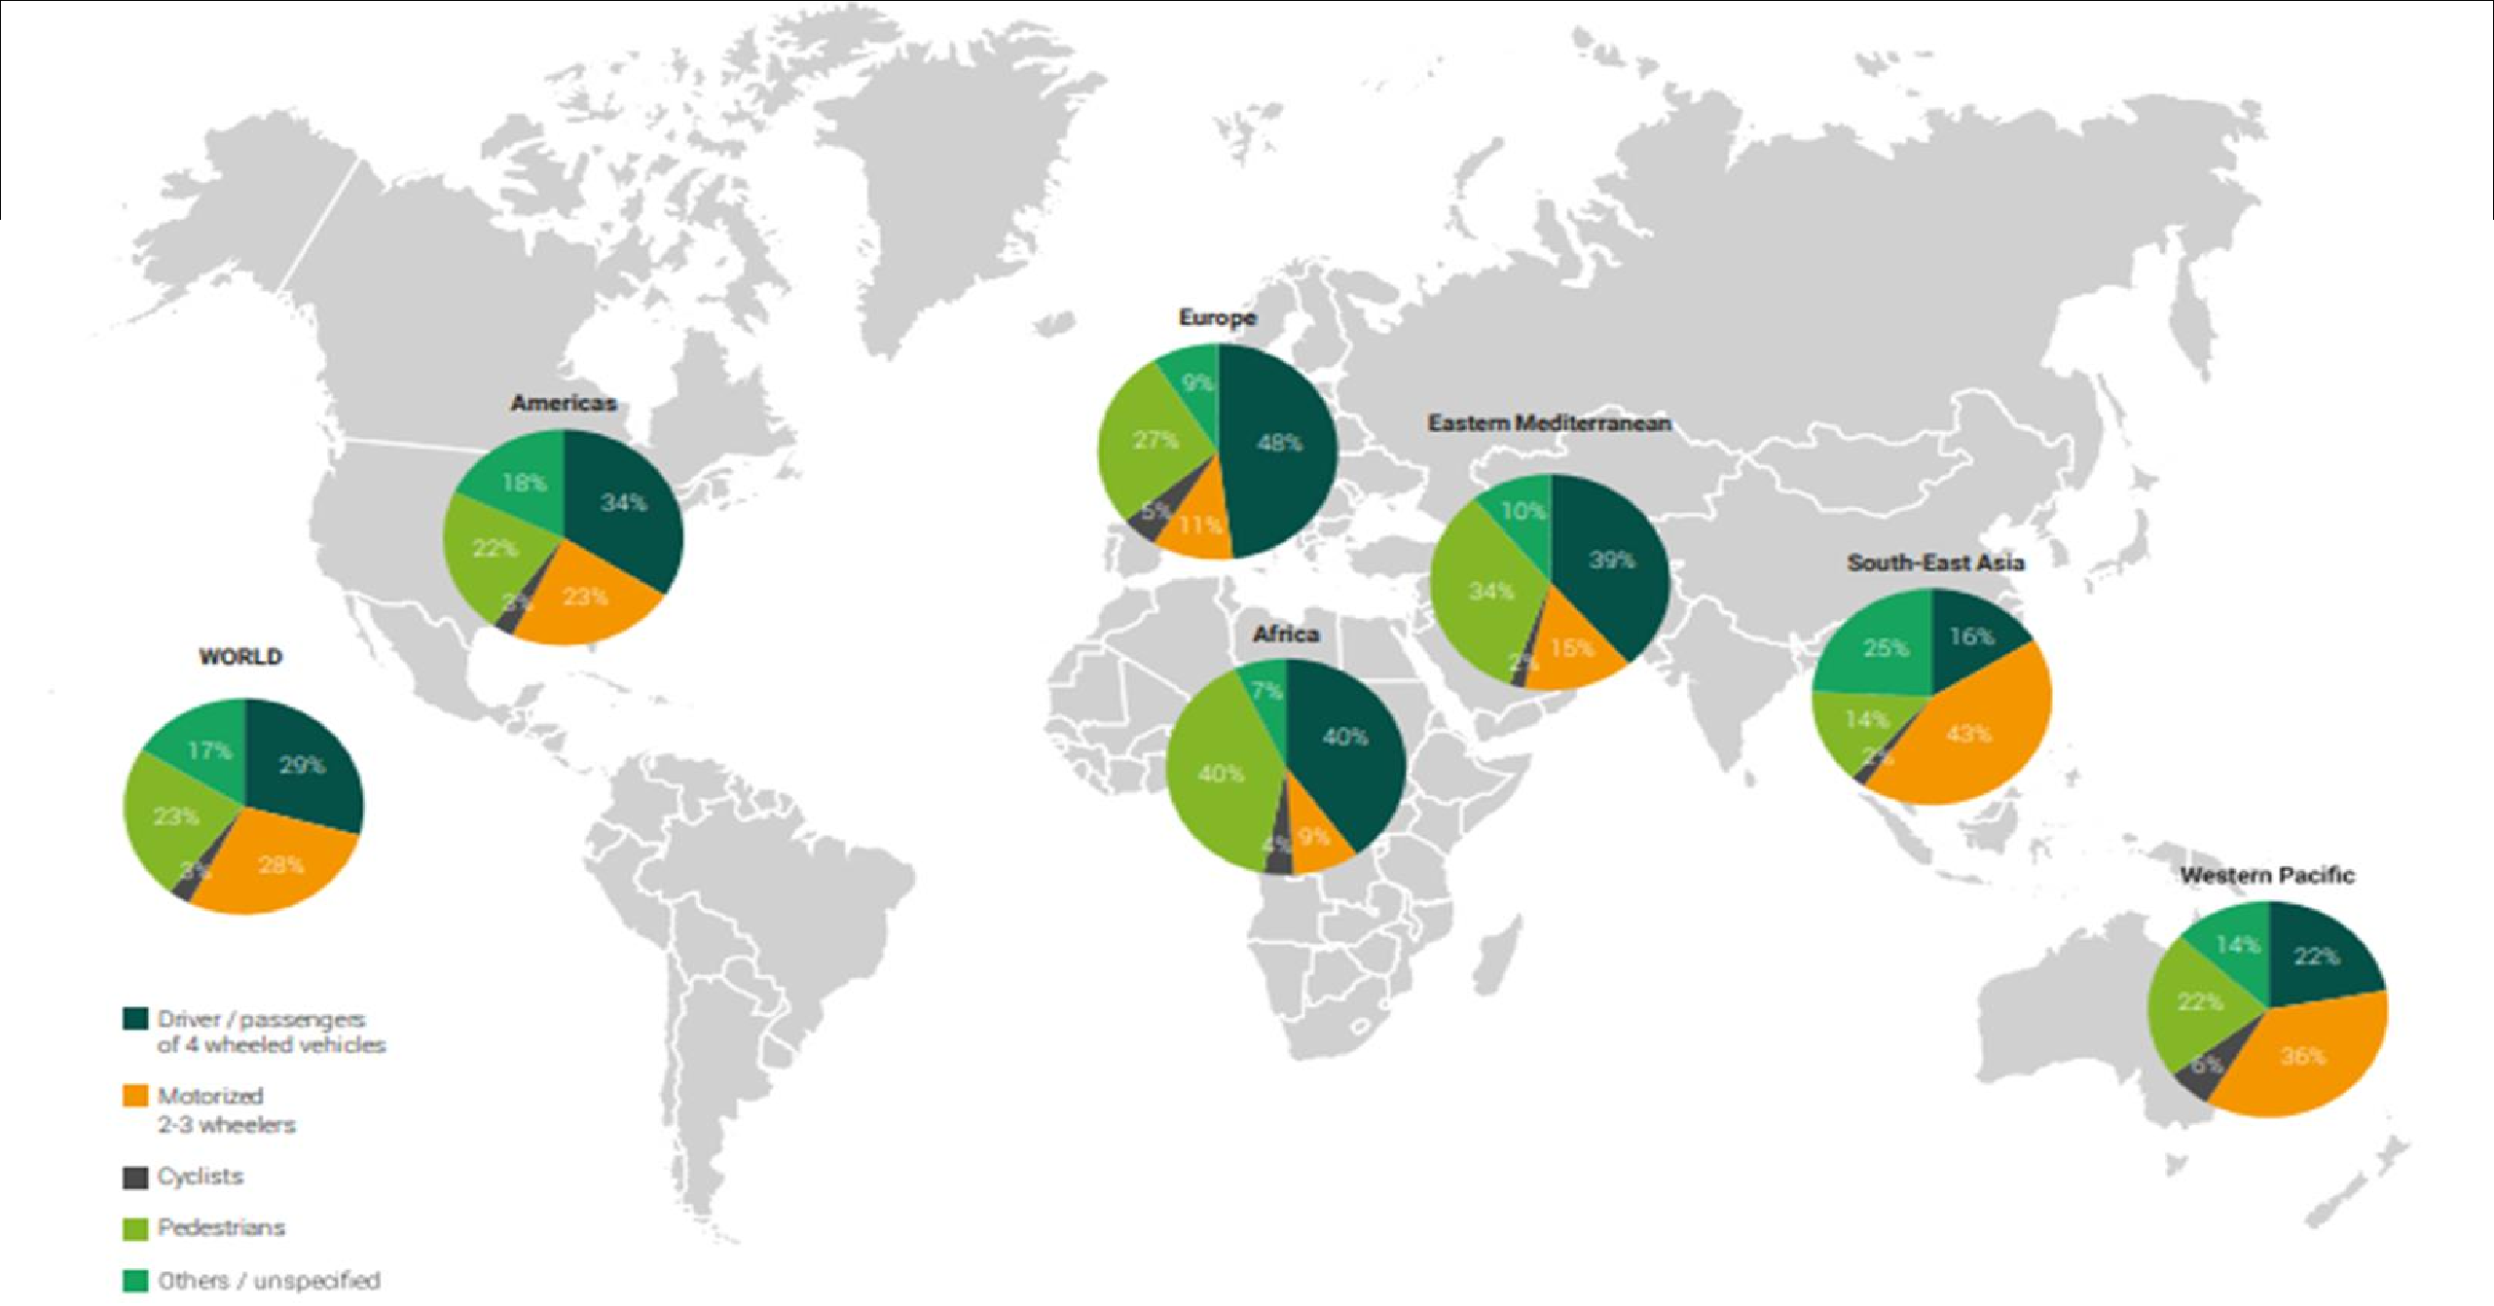
Accidents - Facts

Slide 9
Accidents - Facts (India)
Road accidents in India kill almost 1.5 lakh people annually. Accordingly, India accounts for almost 11% of the accident related deaths in the World.
In 2018 a total of 4,67,044 road accidents were reported by States & Union Territories (UTs) killing 1,51,417 people and causing injury to 4,69,418 persons.
MV Amendment Act 2019: Good Samaritans, Golden hour
Notes:
Good samaritans: The Bill defines a good samaritan as a person who renders emergency medical or non-medical assistance to a victim at the scene of an accident. The assistance must have been (i) in good faith, (ii) voluntary, and (iii) without the expectation of any reward. Such a person will not be liable for any civil or criminal action for any injury to or death of an accident victim, caused due to their negligence in providing assistance to the victim.
Compensation for road accident victims: The central government will develop a scheme for cashless treatment of road accident victims during golden hour. The Bill defines golden hour as the time period of up to one hour following a traumatic injury, during which the likelihood of preventing death through prompt medical care is the highest

Slide 10
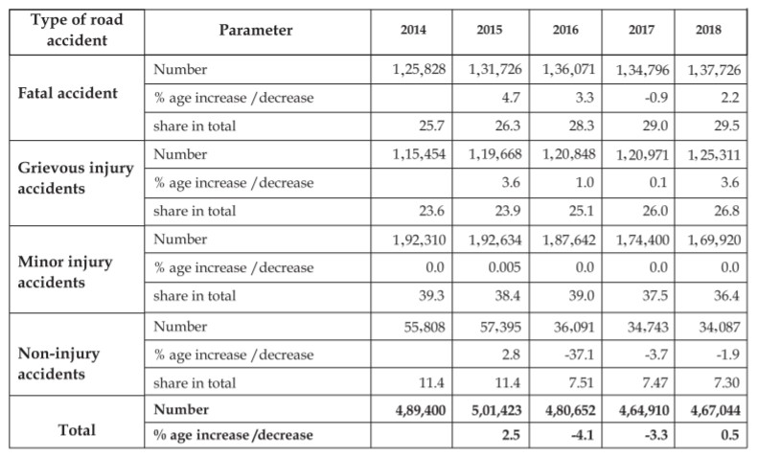
Accidents - Facts (India)
The break up of Road accidents in the above categories in the last five years i.e 2014 to 2018 is presented in table below.
Table 1: Trends in the Type of road accidents (2014 to 2018)

Slide 11
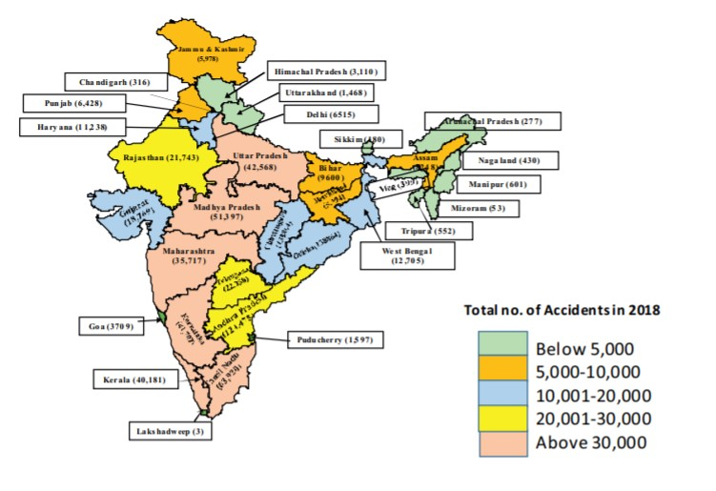
Accidents - Facts (India)
Map 1: Road Accidents in 2018 – State-wise

Slide 12
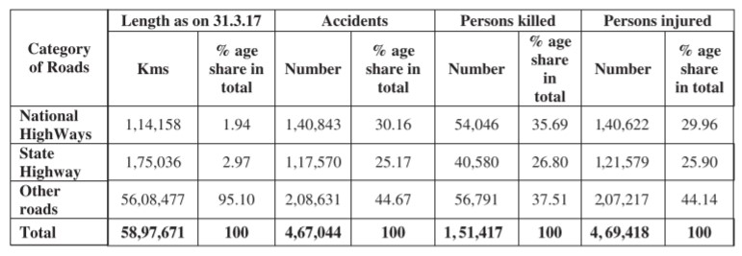
Accidents - Facts (India)
NHs which comprises of 1.94% of total road network accounted for 30.2% of total road accidents and 35.7% of deaths in 2018. SHs which account for 2.97% of the total road length accounted for 25.2% and 26.8% of accidents and deaths respectively. Other Roads which constitute about 95.1% of the total roads were responsible for the balance 45 % of accidents and 38% deaths respectively.
Table 2 : Number of accidents, Number of persons killed and those injured by the category of Roads in 2018

Slide 13
Accidents & it’s cost in Indian Scenario
Road construction and maintenance consume a large proportion of the national budget, while the costs borne by the road-users are often neglected.
According to the study sponsored by the MoRTH, road accident costs alone accounted for at least 0.69% of the GDP of India.
Estimated costs of traffic crashes was revised later to 2–3% of GDP (Mohan 2009).

Slide 14
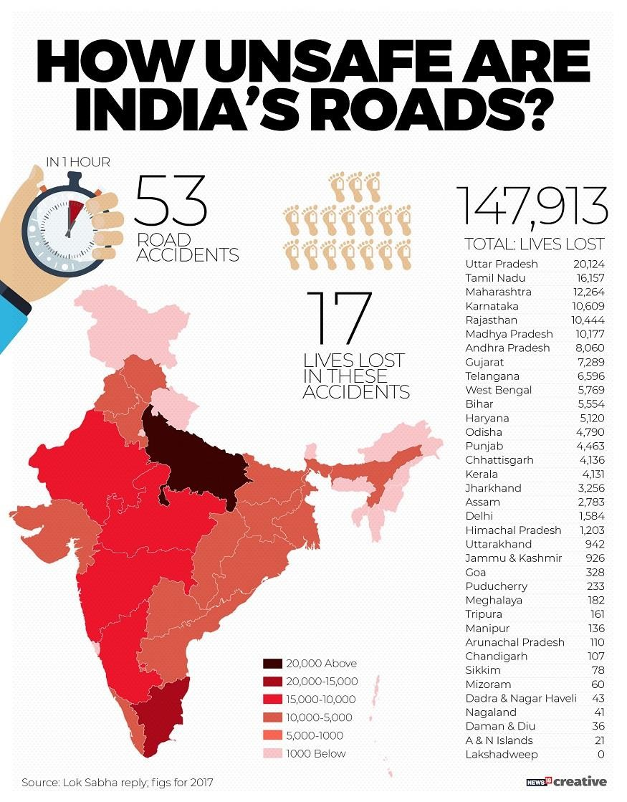
Accidents & it’s cost in Indian Scenario

Slide 15
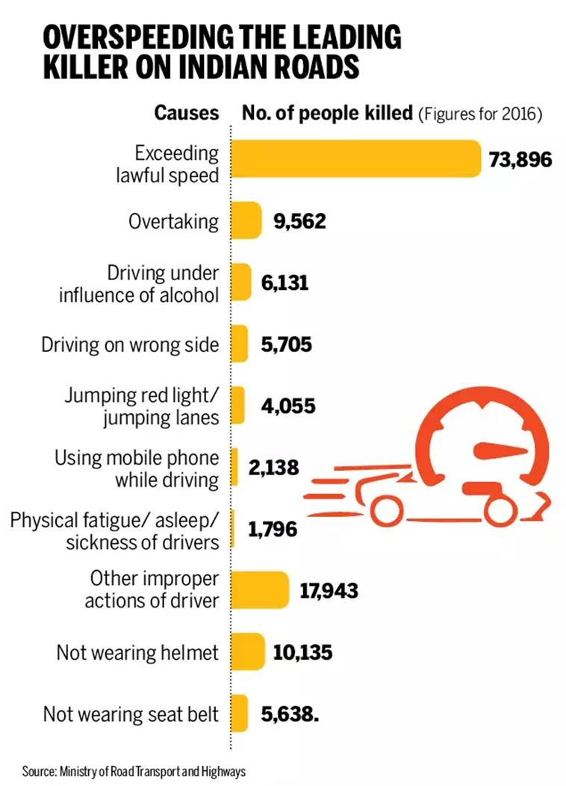
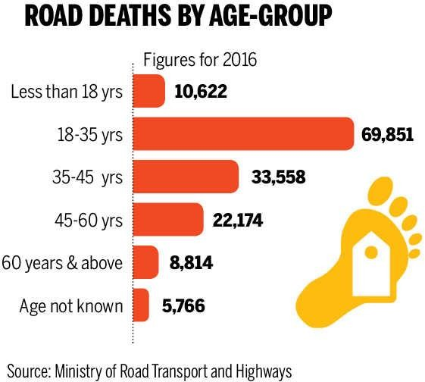
Accidents & it’s cost in Indian Scenario

Slide 16
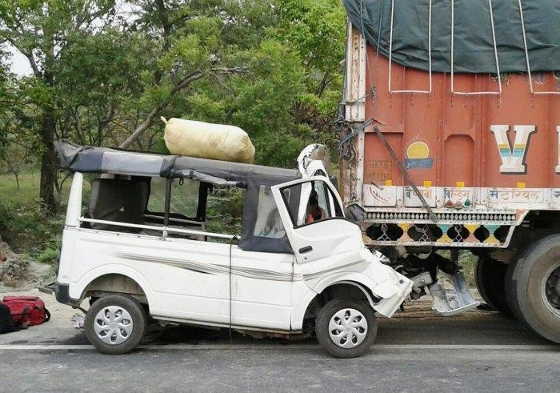
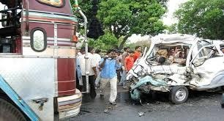
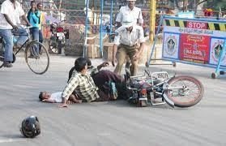
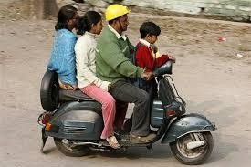
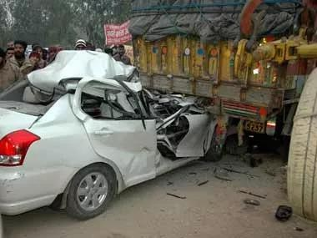
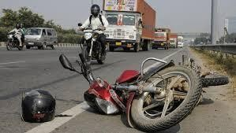
Collision type

Slide 17
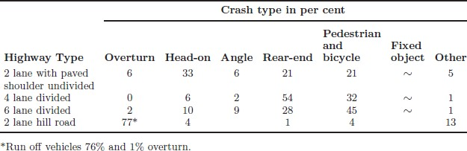
Crash types on Highways
Table 1: Crash Type on Highways (Data from 2010-2014)

Slide 18
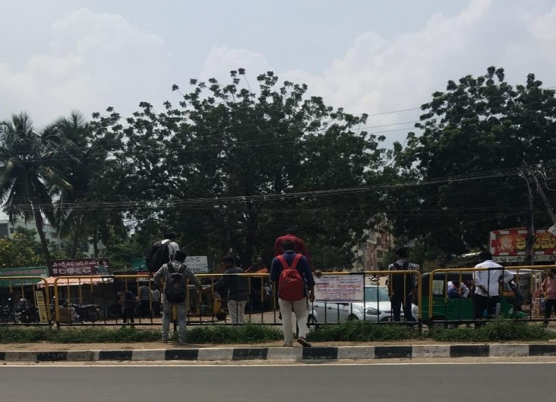
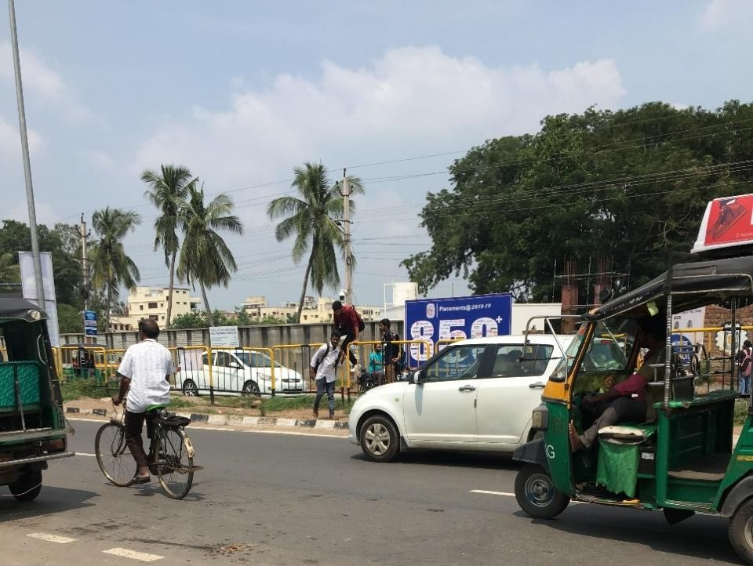
Risk by Pedestrians
(a) | (b)
Snapshots showing (a) students crossing the road over the barrier (b) the risk faced by the pedestrians while crossing the road while mounting over the barriers

Slide 19
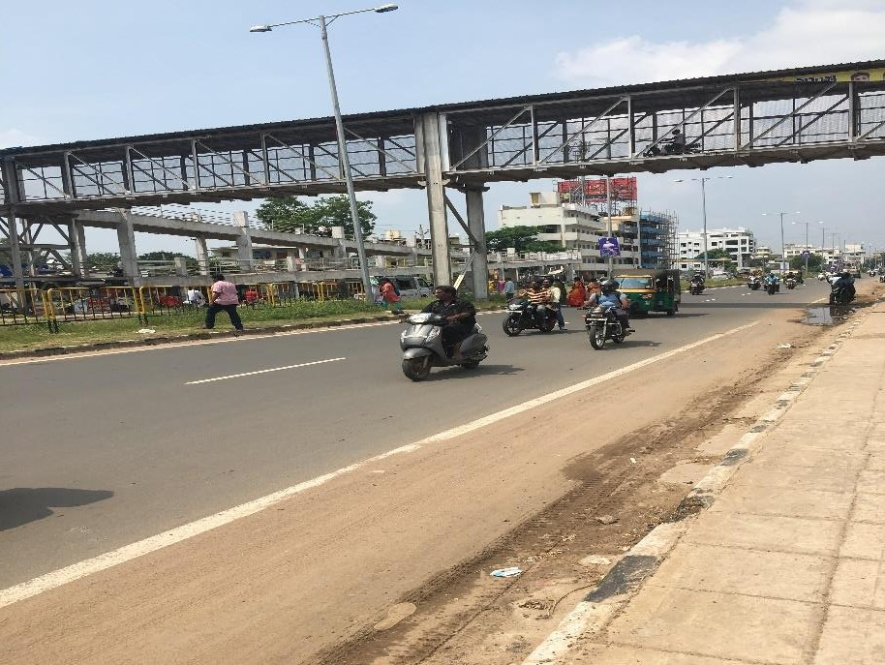
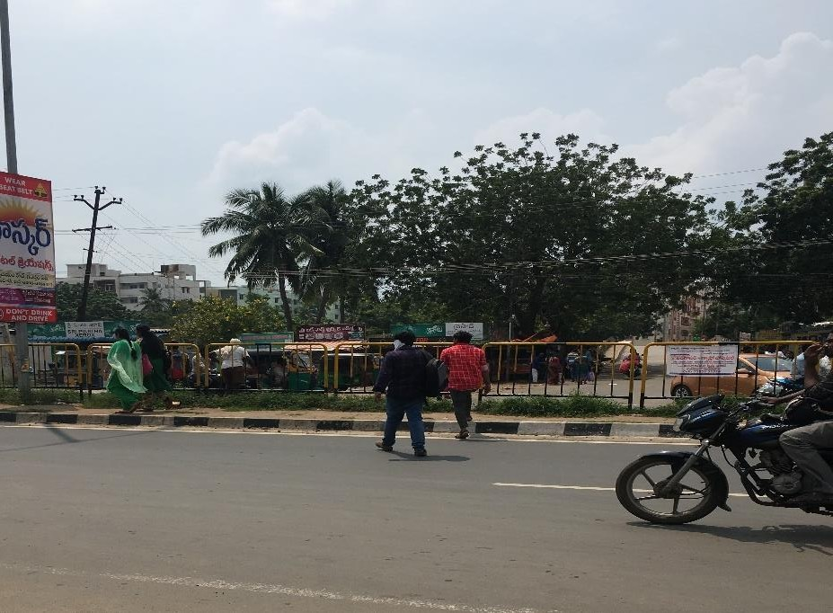
Risk by Pedestrians - MTWs
(b)
Snapshots showing (a) pedestrain crossing at grade and motorbikes crossing on FOB (b) pedestrain crossing the road

Slide 20
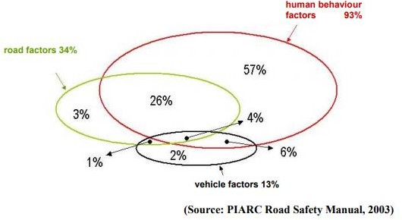
Who is contributing ?

Slide 21
Causes of Road Accident
Driver or Operator Action:
Major contributing cause of many crash situations is the performance of the driver of one or both
Vehicle Condition:
Mechanical condition of a vehicle can be the cause of transportation crashes
Roadway Condition:
The condition and quality of the roadway, which includes the pavement, shoulders, intersections, and the traffic control system, can be a factor in a crash
Environment:
The physical and climatic environment surrounding a transportation vehicle can also be a factor in the occurrence of transportation crashes.

Slide 22
Causes of Road Accident
Road accidents are multi-causal and are the result of an interplay of various factors.
These can broadly be categorized into those relating to
Human error
Road condition
Environment
Vehicular condition.

Slide 23
Causes of Road Accident – Human Error
Accidents caused by human error include
Cases of accidents caused by traffic rule violations
Driving without valid driver license
Non-use of safety devices
Accident related deaths and injuries in 2018 with Over Speeding accounting for 66.5% of the road accidents , 64.4% of total deaths and 67.7% of total injuries.
Driving on the wrong side/lane indiscipline is the second most important cause accounting for 5.3% of the road accidents , 5.8% of total deaths & 5.1% of total injuries.

Slide 24
Causes of Road Accident – Human Error
Drunken driving/ consumption of alcohol & drug, jumping of red light and use of mobile phones taken together accounted for 6.5% of total accidents and 6.2% of total deaths.
The others category which would include reasons like road environment, vehicular condition etc accounted for almost 23-24% of the accidents, accident related deaths and injuries.

Slide 25
Causes of Road Accident – Human Error
Vehicles driven by untrained and unqualified drivers are a serious traffic hazard and can cause accidents, death and injuries. Though the problem is basically an enforcement issue, it must also be addressed with better facilities and opportunities for training/skilling and evaluation/testing.
About 74% of road accidents involved drivers holding a valid driver license. Road accidents involving drivers without valid driving license decreased from 48,503 in 2017 to 37, 585 in 2018 registering a decline of 22.5% and accounted for 8.0% of the total accidents.

Slide 26
Causes of Road Accident – Human Error
Accidents involving learners license also declined from 33,128 in 2017 to 23,593 in 2018 by about 28.8% and accounted for about 5.1% of the total accidents.
Together accidents without valid driving license and with learners license account for 13.1% of accidents.

Slide 27
Causes of Road Accident – Human Error
Non usage of safety devices such as helmets and seat belts do not cause accidents but are critical for averting fatal and grievous injuries in an event road accident occurs.
Non-wearing of helmets by two wheeler riders caused 43,614 deaths and accounted for 28.8% of total road accident deaths in the country during 2018. The number of drivers killed were 28,250 and the passengers killed were 15,364.

Slide 28
Causes of Road Accident – Human Error
Seat belts are another safety device which is mandatory for both the driver and the persons in vehicles other than two-wheelers and three-wheelers.
In 2018, Non-wearing of seat belts was found to be associated with 24,435 deaths and accounted for 16.1% of total road accident deaths in the country during 2018 involving 9,349 drivers and 15,086 passengers.

Slide 29
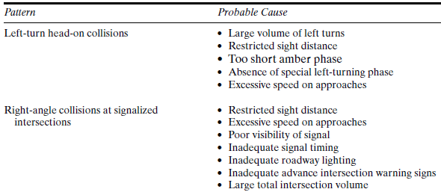
Types of Crashes- Probable Causes

Slide 30
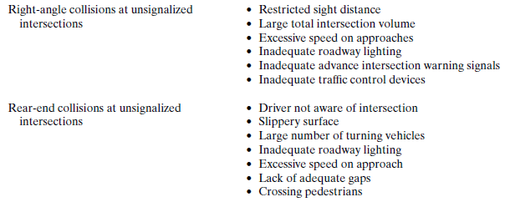
Types of Crashes- Probable Causes

Slide 31
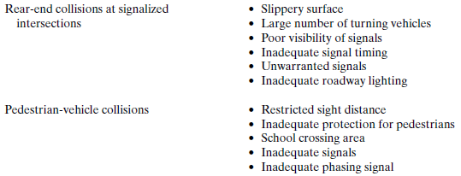
Types of Crashes- Probable Causes
Considerable proportion of accidents occur on relatively short sections called Black Spots or Black sites

Slide 32
Road Accident Investigation
Road Accident Investigation
Intervention/policy
Suggestion for Improvement

Slide 33
Scientific investigations
For each type of accident, three questions should be asked:
What driver actions lead to the occurrence of such accidents?
What existing conditions at the site could contribute to drivers taking such actions?
What changes can be made to reduce the chances of such actions taking place?

Slide 34
Investigative approaches used to develop accident reduction programmes
There are four main investigative approaches used to develop accident reduction programmes. These are described as:
Single site schemes
Mass action programmes
Route action programmes; and
Area action programmes.

Slide 35
Investigative approaches used to develop accident reduction programmes
All involve four major planning steps:
Data collection, storage and retrieval,
Identification of hazardous locations for further study
Diagnosis of the accident problem(s), and
The final selection of sites to be included in the remedial implementation programme

Slide 36
Accident Data
Data collection and representation

Slide 37
Accident Data Collection
The accidents occur infrequently and at unpredictable times and locations, they cannot be directly observed and studied in the field
All accident data comes from secondary sources-primarily police and motorist accident reports.
Accident data requirements:
Accuracy: to be described the data exactly
Complexity: to be involved all the relevant parameters.
Availability: to be available for all the users
Uniformity: to apply standard definition

Slide 38
Accident Data Collection
The information is needed for a wide variety of purposes, including:
Identification of locations at which unusually high numbers of accidents occur.
Detailed functional evaluations of high-accident locations to determine contributing causes of accidents.
Development of general statistical measures of various accident-related factors to give insight into general trends, common causal factors, driver profiles, and other factors.
Development of procedures that allow the identification of hazards before large numbers of accidents occur.

Slide 39
Accident Data Collection
As in most countries, traffic police are the source of official government statistics related with road traffic injuries in India.
The main sources of traffic crash data at the national level are the annual reports published by the National Crime Record Bureau (NCRB), Ministry of Home Affairs, and the annual publication of the Ministry of Road Transport & Highways (MoRTH) titled Road Accidents in India.
The basic information for both these reports comes from all the police stations in the country based on the cases reported to them https://data.gov.insectors/Transport-9383

Slide 40
Accident Data Collection
The International Road Traffic and Accident Database (IRTAD) is a data collection maintained by the Organisation for Economic Co-operation and Development (OECD) and the International Transport Forum (ITF) in Paris, covering safety data in countries within and outside of Europe.

Slide 41
Accident Reports
Motorists accident reports-filed by each involved motorist in a traffic accident; required by state law for all accidents with total property damage exceeding a proscribed limit, and for all accidents involving injuries and fatalities.
Police accident reports-filed by an attendant police officer for all accidents at which an officer is present. These would generally include all fatal accidents, most accidents involving a serious injury requiring emergency and/or hospital treatment, and PDO accidents involving major damage.
It is estimated that police accident reports are filed for approximately 50% of all traffic accidents that occur.

Slide 42
Accident Studies
As traffic safety is the primary responsibility of the traffic engineer, the focused study of accident characteristics, in terms of system wide rates, relationships to causal factors and at specific locations, is a critically important function
Various objectives of the accident studies may be listed as:
To study the causes and to suggest corrective treatment
To evaluate existing designs
To support proposed designs
To carryout before and after studies and to demonstrate the improvement in the problem
To give economic justification for the improvements suggested by the traffic engineer

Slide 43
Accident Records
Location files
Useful to keep a check on the location of accident and to identify points of high accident incidence (Black spots)
Spot maps
Accident location spot maps show accident by spots, pins or symbols on the map
Condition diagram
It is drawn to scale showing all important physical conditions of an accident location to be studied
Important features are: road way limits, kerb lines, bridges, trees and all details of road way conditions, obstruction to vision, signs, signals e.t.c
Collision diagram
Diagrams showing the approximate path of vehicles and pedestrians involved in the accidents
Most useful to compare accident pattern before and after remedial measures have been taken

Slide 44
Who manages Accident Data
Police
Road administration
Hospitals/health system
Insurance Companies

Slide 45
Accident Type
Single vehicle accidents
Rear end Collision/Accident: A rear-end accident occurs when one vehicle collides with the back end of another vehicle. The most common cause of these accidents is the trailing vehicle following too close. Determining fault in a rear-end accident is usually pretty straight-forward
Road accidents of oncoming vehicles on the road section

Slide 46
Accident Analysis
Accident analyses allow the correlation of accident types with highway types and specific geometric elements, the identification of high-risk driver populations, quantifying the extent of DUI/DWI influence on accidents and fatalities, and other important determinations.
Many of these factors can be addressed through policy or programmatic approaches
Changes in the design of guardrails have resulted from the correlation of accident and fatality rates with specific types of installations

Slide 47
Accident Analysis
Changes in the legal drinking age and in the legal definition of DUI/DWI have resulted partially from statistics showing the very high rate of involvement of this factor in fatal accidents.
Improved federal requirements on vehicle safety features (air bags, seat belts and harnesses, energy-absorbing steering columns, padded dashboards) have occurred partially as a result of statistics linking these features to accident severity

Slide 48
5Es to Road safety
Road safety is result of effective measures and their integration in the areas of
Engineering (Roads)
Engineering(Vehicles)
Enforcement
Education
Emergency

Slide 49
5Es to Road safety
Engineering (Roads)
Road Design and Maintenance
Segregation of traffic
Lighting system
Speed
Double white lines
Alignment
Road Surface
Margins
Engineering (Vehicles)
Vehicle Design and maintenance

Slide 50
5Es to Road safety
Enforcement
Speed control
Traffic control
Training and supervision
Medical check
Compulsion to wear Helmet, seat belt
Education
Road users (pedestrians, drivers) training, education, Traffic rules, traffic safety week programs etc.
Emergency
Rs 14,000 cr to be spent to cut road accidents-11.07.2019 https://www.socialnews.xyz/2019/07/11/rs-14000-cr-to-be-spent-to-cut-road-accidents/

Slide 51
Accident Assessment
Accident Density (Ad):
𝐴 𝐴𝑐𝑐𝑖𝑑𝑒𝑛𝑡
^{𝐴𝑑 =} 𝐿. 𝑇 𝐾𝑚. 𝑦𝑒𝑎𝑟
where:
L: the length of the investigated road section or road network (km) A: the number of accidents occurred on the section or network with length “L”.
T: the number of years.

Slide 52
Accident Assessment
Accident rate(Ar):
𝐴. 10⁶ 𝐴𝑐𝑐𝑖𝑑𝑒𝑛𝑡
^{𝐴𝑟 =} 365. 𝐴𝐴𝐷𝑇. 𝐿. 𝑇 10⁶𝑉𝑒ℎ𝑐𝑙𝑒𝑘𝑚
where:
AADT: annual average daily traffic (vehicle/day)
Note: The relationship between traffic volume and accidents can be expressed as follows: (Elvik and Vaa, 2004):
𝐴 = 𝑎. 𝑄^{𝑏}
Where:
A= Number of Accidents; Q = traffic volume; a&b=constants

Slide 53
Safety Performance Function (SPF)
SPF is an equation used to predict the average number of crashes per year at a location as a function of exposure and, in some cases, roadway or intersection characteristics (e.g., number of lanes, traffic control, or median type) (1).
For highway segments, exposure is represented by the segment length and annual average daily traffic (AADT) associated with the study section

Slide 54
Safety Performance Function (SPF)
Application: SPFs are used to predict crash frequency for a given set of site conditions. The predicted crashes from the SPF can be used alone or in combination with the site-specific crash history (i.e., Empirical Bayes method) to compare the safety performance of a specific site under various conditions.
The Empirical Bayes method is used to estimate the expected long-term crash experience, which is a weighted average of the observed crashes at the site of interest and the predicted crashes from an SPF.

Slide 55
Nonparametric Method
The nonparametric approach is simple to apply and only assumes a Poisson distribution for the accidents.
To estimate the number of accidents, a_{k} expected to occur in an equivalent after period on a system that had k accidents in the before period, we need
N_{k} = number of systems with k accidents, and
N_{k+1} = number of systems with (k+1) accidents.
Now, a_{k} =(k+1)*N_{(k + 1)}/N_{k}

Slide 56
Empirical Bayes Method
The empirical Bayes method assumptions are (1) a Poisson distribution for the accidents, and (2) a Gamma distribution for the distribution of the averages in the population of systems.
With these two assumptions, the number of systems with k accidents must obey the negative binomial distribution. The expected number of accidents, a’_{k}, in the after period on a system that had k accidents in the before period is
a'_{k} =(k+1)*N’_{(k + 1)}/N’_{k}

Slide 57
Identifying High-Accident locations
A primary function of an accident record system is to regularly identify locations with an unusually high rate of accidents and/or fatalities
Accident spot maps are a tool that can be used to assist in this task
Computer record systems can also produce lists of accident locations ranked by either total number of accidents occurring or by defined accident or fatality rate. It is useful to examine both types of rankings, as they may yield significantly different results.

Slide 58
Identifying High-Accident locations
Some locations with high accident numbers reflect high volumes and have a relatively low accident rate. Conversely, a small number of accidents occurring at a remote location with very little demand can produce a very high accident rate.
Statistical rankings give the engineer a starting point, judgment must still be applied in the identification and selection of sites most in need of improvement during any given budget year

Slide 59
Application of computer analysis of accident data
TEAAS-Traffic Engineering Accident Analysis System: a Software used to analyze the accident data ( North Carolina)
FARS (Fatality Analysis Reporting System)
GES (General Estimates System) UK
Road Accident Data Management System (RADMS) India

Slide 60
Approaches to Highway Safety
Strategies that may be employed to improve highway traffic safety
Exposure control
Accident prevention
Behaviour modification
Injury control
Post-injury management
Road Safety Audit

Slide 61
Approaches to Highway Safety - Exposure control
Reduce the travel by motorists
Efforts to reduce auto use and travel cover a wide range of policy, planning, and design issues.
Policies and practices that attempt to reduce Auto/Vehicle use include:
Diversion of travel to public transportation modes
Substitution of telecommunications for travel
Implementation of policies, taxes, and fees to discourage auto ownership and use Reorganization of land uses to minimize travel distances for various trip purposes
Driver and vehicle restrictions through licensing and registration restrictions

Slide 62
Approaches to Highway Safety – Accident Prevention
Accident prevention involves a number of policy measures, including
Driver and pedestrian training
Removal of drivers with “bad” driving records and
Provision of better highway designs and control devices that encourage good driving practices and minimize the occurrence of driver error
Risk control, or reduction of severity, often involves the design and protection of roadside and median environments
Proper guardrail and/or impact-attenuating devices will reduce the impact energy transferred to the vehicle in an accident, and can direct the path of a vehicle away from objects or areas that would result in a more serious collision

Slide 63
Approaches to Highway Safety – Behaviour Modification
Behaviour Modification is an important component of strategies for Accident prevention and Exposure reduction
Providing very high-class and convenient public transportation alternatives
Implementing policies that make public transportation a much more attractive alternative than driving
Driver and pedestrian training programs
Very effective strategy in behavior modification is enforcement

Slide 64
Approaches to Highway Safety – Injuri Control
Seat belts and shoulder harnesses, and laws to enforce their use
Child-restraint seats and systems, and laws requiring their use
Anti-burst door locks
Padded instrument panels
Energy-absorbing steering posts and crumple zones
Side door beams
Air bags
Head rests and restraints
Shatterproof glass
Forgiving interior fittings

Slide 65
Approaches to Highway Safety –
Post-injury management
50% of traffic fatalities occur with in few minutes of accident
35% with in 1-2hours of accident
15% with in 30days in hospital
There is little that can be done for deaths occurring during the accident or immediately thereafter
Biggest opportunity for improvement is in the 2nd category, Deaths within 1-2 hours of an accident can be reduced by
Speedy emergency medical responses
High-quality emergency care at the site and during transport to a hospital
Speedy notification of emergency services
Fast dispatch of appropriate equipment to the site
Well-trained emergency medical technicians attending to immediate medical needs of victims, and
well staffed and equipped trauma centers at hospitals

Slide 66
Approaches to Highway Safety – Road Safety Audit (RSA)
Behaviour Modification is an important component of strategies for Accident prevention and Exposure reduction
RSA is the formal safety performance examination of an existing or future road or intersection by an independent, multidisciplinary team
It qualitatively estimates and reports on potential road safety issues and identifies opportunities for improvements in safety for all road users
The aim of an RSA is to answer the following questions:
What elements of the road may present a safety concern: to what extent, to which road users, and under what circumstances?
What opportunities exist to eliminate or mitigate identified safety concerns?

Slide 67
Collision diagrams
Creation and usage of collision diagrams is a very simple and efficient tool when conducting road accident analysis
Collision diagrams show important road accident patterns with graphic symbols
They give broader understanding of the accidents along with contributory factors
They don’t supply extensive text document

Slide 68
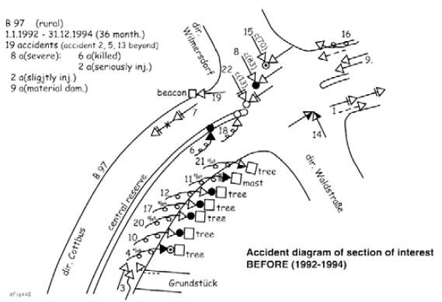
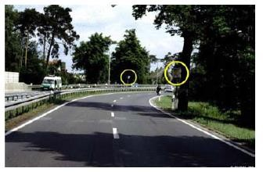
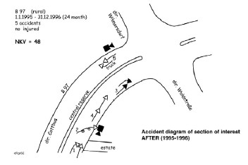
Collision diagrams continued…
Accident Curve –Germany (Before and after)
Solution: Speed monitoring system

Slide 69
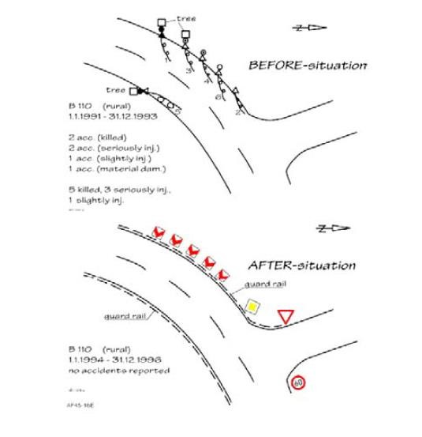
Collision diagrams continued…
Collision diagram is used in before and after study comparison evaluation
Source- PIARC Manual
EXAMPLE OF BEFORE/AFTER EVALUATION

Slide 70
Example (the Czech Republic):
Pedestrian crossing on a main urban route
Problems
Unsuitable drainage, water staying on the road (pedestrians trying to deal with the water obstacle fail to observe approaching vehicles)
The crossing is unsuitably placed, and is abrupt from the psychological point of view of motorists – see Figure 6-1 (road marking is insufficiently distinct for approaching drivers. The situation worsens in wet conditions)
The crossing is too long (9 m), and not equipped with a traffic island– see Figure 6-3 and Figure 6-2 .
The speed of passing cars is too great

Slide 71
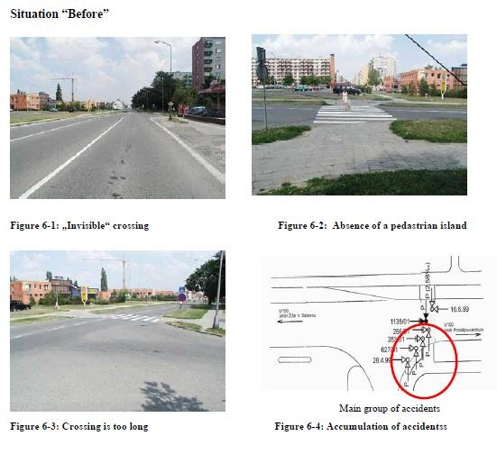
Example (the Czech Republic):
Pedestrian crossing on a main urban route
Source- PIARC Manual

Slide 72
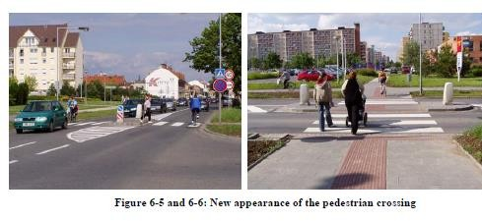
Example (the Czech Republic):
Pedestrian crossing on a main urban route
Solution
Repair water drainage
Protect pedestrians by implementing the
traffic island
Improved street lighting, pedestrian crossing lighting, accessories for blind people
Outcome
No accidents in the following 3 year period
Source- PIARC Manual

Slide 73
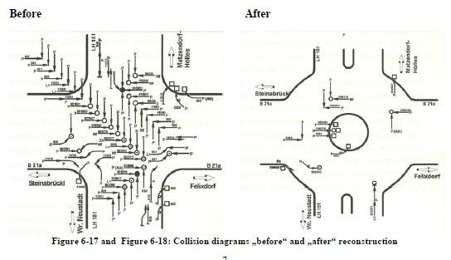
Example 2: Austria
Rural intersection with high accident rates
Source- PIARC Manual

Slide 74
Example 2: Austria
Rural intersection with high accident rates
Safety problems
High speeds on the main road invokes serious accidents High traffic volumes on both roads
Large collision area for potential events
Solution
Redesign crossing as a roundabout
Standard improvements are not sufficient enough in this case

Slide 75
Accident Analysis
Statistical Methods: Basic Terminology, Probability, Regression, before and after methods, Accident severity Index, False positives and False negatives

Slide 76
Basic Terminology
Mean
The arithmetic mean is the average of a group of numbers and is computed by summing all numbers and dividing by the number of numbers.
Problem : Following is the accident data set for a week at an intersection has a mean of 8. Find the value of x ?
Day | Mon | Tue | Wed | Thu | Fri | Sat | Sun
No of Accidents | 12 | 5 | 7 | 8 | X | 10 | 5

Slide 77
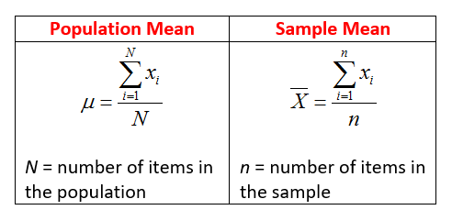
Basic Terminology
Mean
Population mean and sample mean:
A population is a collection of persons, objects or items of interest.
A sample is a portion of the whole and, if properly taken, is representative of the whole.
The sample mean is often used to estimate the population mean. It is sensitive to the outliers.
Alternatives: Median and Mode

Slide 78
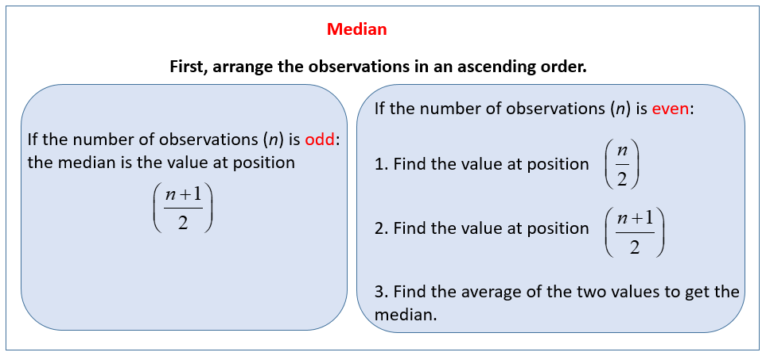
Basic Terminology
Median

Slide 79
Basic Terminology
Mode
Most common value among the given observations. For example, a person who sells ice creams might want to know which flavor is the most popular.

Slide 80
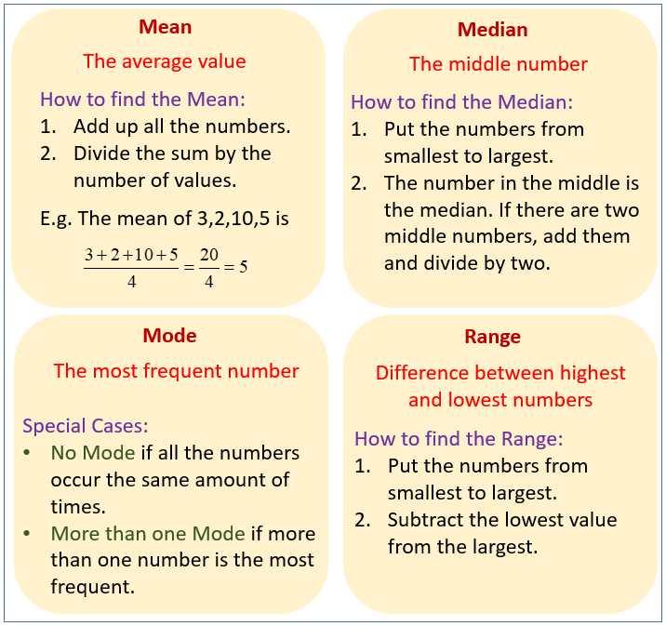
Basic Terminology

Slide 81
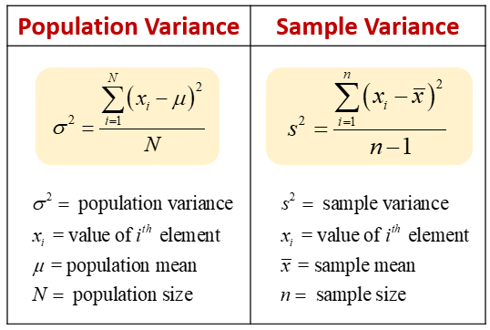
Basic Terminology
Variance
It measures the dispersion in the data
Mean is the measure of the location of distribution whereas variance is the way to describe the degree of being spread out.

Slide 82
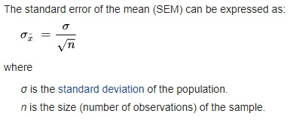
Basic Terminology
Standard error of the estimate
The standard error (SE) of the estimate is the estimation of the accuracy of any predictions.

Slide 83
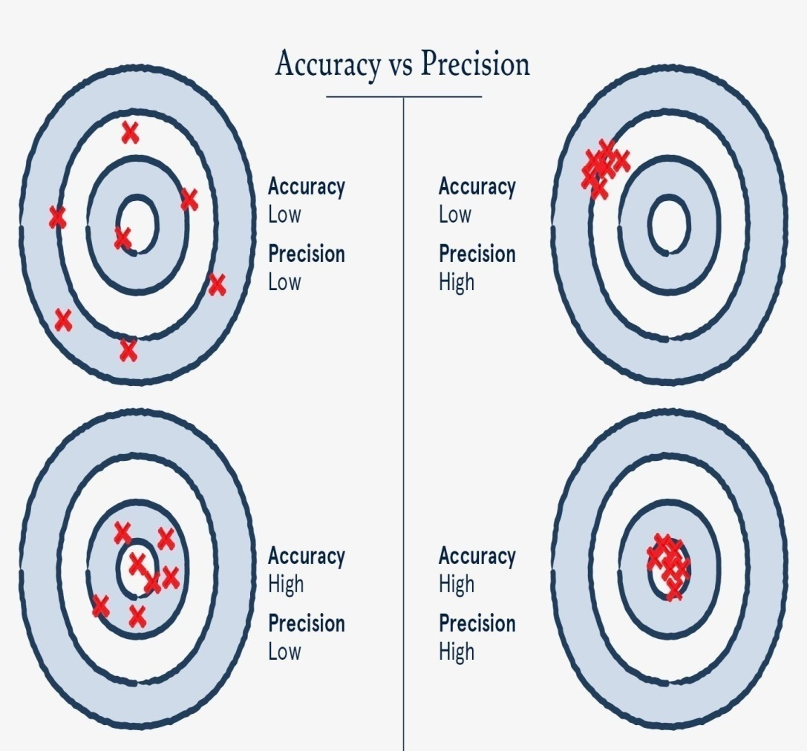
Basic Terminology
Accuracy and precision
Accuracy: Closeness of estimates / measurements / observed values to the true or expected value
Precision: refers to how close measurements are to each other

Slide 84
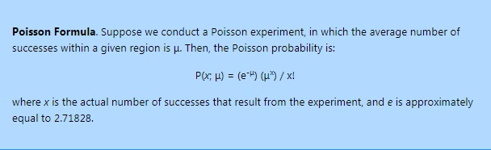
Poisson Distribution
It is used to model the number of events occurring within a given interval
Formula for the Poisson probability mass function is:
λ is the shape parameter which indicates the average number of events in the given time interval
PD can also be used for the specified intervals such as distance, area and volume

Slide 85
Poisson Distribution- applications
Used in the modelling of events such as
The number of people killed found per unit length of road The number of times a web server is accessed per minute
The number of cars pass through a certain point on a road during a given period of time
Number of road accidents occurring on a NH, Bypass and so on

Slide 86
Other statistical distributions
Binomial
Negative Binomial
Chi-square test

Slide 87
Before and after studies
Naïve before and after study
Before and after study with yoked comparison
Before and after study with comparison group
Before and after study with Empirical Bayes approach

Slide 88
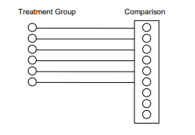
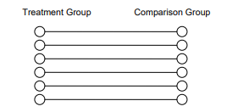
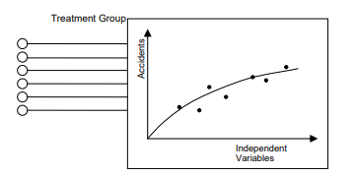
comparison group
Yoked comparison
Empirical Bayes approach

Slide 89
Accident severity Index- Identification of blackspots
Definition of Black spot (MoRTH):
Road accident black spot on National Highways is a road stretch of about 500m in length in which either 5 road accidents (involving fatalities/grievous injuries) took place during last three calendar years or 10 fatalities took place during last three calendar years.

Slide 90
Accident severity Index- Identification of blackspots
Hazardous locations are evaluated based on Accidents Severity index (ASI). Hazardous spots with Accidents Severity Index (ASI) more than Threshold value (Average Severity + 1.5*Standard Deviation) will be treated as Black spots.
For estimation of ASI, the weightage to fatal accident will be assigned as 7 and to grievous injury accident as 3, was considered based on NHAI's criteria
𝐴𝑆𝐼 = 𝑁_{𝑓}𝑊_{𝑓} + 𝑁_{𝑠}𝑊_{𝑠} + 𝑁_{𝑚}𝑊_{𝑚}
Where 𝑁_{𝑓}= number of fatalities in last three years
𝑁_{𝑠}= number of serious accidents in last three years
𝑁_{𝑚}= number of minor accidents in last three years

Slide 91
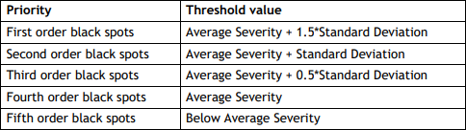
Accident severity Index- Identification of blackspots
Table: Threshold value of priority black spots

Slide 92
Other techniques for identifying Hazardous Locations
Upper tail accident count Upper tail accident rate
Upper tail accident count and High accident rate
Upper tail expected number of accidents (Empirical Bayes approach)
Upper tail EB dispersion criteria

Slide 93
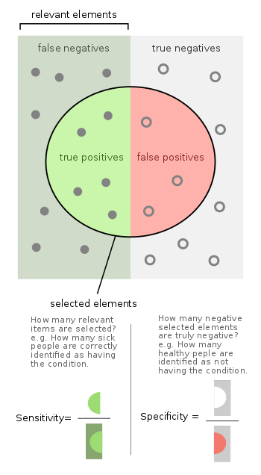
Evaluation criteria for the methods: Confusion Matrix False positives and False negatives
Confusion Matrix describes false positives and false negatives
To evaluate the diagnostic performance of different techniques the following methods are used
_{𝑆𝑒𝑛𝑠𝑖𝑡𝑖𝑣𝑖𝑡𝑦 =} 𝑛𝑢𝑚𝑏𝑒𝑟 𝑜𝑓 𝑐𝑜𝑟𝑟𝑒𝑐𝑡𝑒𝑑 𝑝𝑜𝑠𝑖𝑡𝑖𝑣𝑒𝑠
𝑡𝑜𝑡𝑎𝑙 𝑛𝑢𝑚𝑏𝑒𝑟 𝑜𝑓 𝑝𝑜𝑠𝑖𝑡𝑖𝑣𝑒𝑠
_{𝑆𝑝𝑒𝑐𝑖𝑓𝑖𝑐𝑖𝑡𝑦 =} 𝑛𝑢𝑚𝑏𝑒𝑟 𝑜𝑓 𝑐𝑜𝑟𝑟𝑒𝑐𝑡𝑒𝑑 𝑛𝑒𝑔𝑎𝑡𝑖𝑣𝑒𝑠
𝑡𝑜𝑡𝑎𝑙 𝑛𝑢𝑚𝑏𝑒𝑟 𝑜𝑓 𝑛𝑒𝑔𝑎𝑡𝑖𝑣𝑒𝑠

Slide 94
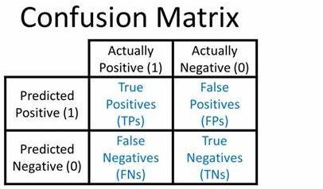
Evaluation criteria for the methods: Confusion Matrix False positives and False negatives
Note: A good diagnostic test perform well in reation to both sensitivity and specificity.

Slide 95
Accident Reconstruction
Force and Energy Theory

Slide 96
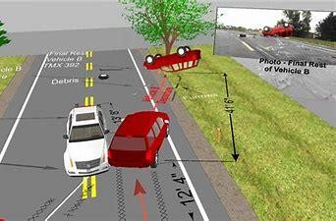
Need of conducing collision reconstruction
Many accidents have serious consequences such as economic, physical disabilities and death
Mostly Two people are involved and blame each other
Insurance policies need evidence

Slide 97
Traffic collision reconstruction -Definition
It is the scientific process of investigating, analyzing and drawing conclusion about causes and events during collision
Schematic diagram is developed to estimate speeds before, during and after the collison based on observed data
Especially determination of pre-collison speeds helps in developing policy measures to reduce accidents

Slide 98
Traffic collision reconstruction-Data
Data from the field and police reports, statements from the eye witness and drivers involved in the accident
Data required for analysis are: mass of the vehicles involved in collision, final velocities of the vehicles, length of skid marks to estimate path of the vehicles while approaching collision
Collison may be collinear or angular

Slide 99
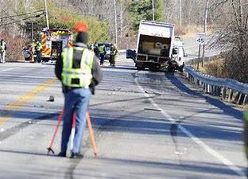
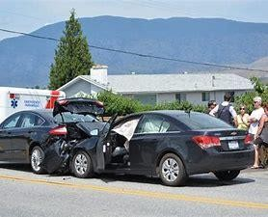
Collinear Collision
Skid marks measurement

Slide 100

Traffic collision reconstruction
Analyze the collected data to reconstruct the time line of events
Human and Environmental Factors
Physical Factors: Newton laws, Energy and Momentum principles

Slide 101
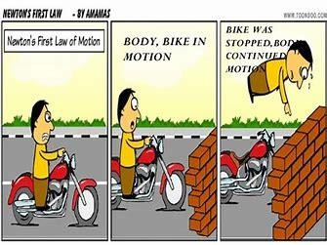
Newton first law
Inertia: “An object either remain at rest or in motion with constant speed in the same direction until some force acts upon it”

Slide 102
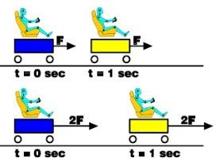
Newton second law
“An acceleration of the body is directly proportional to resulting force acting on it and inversely proportional to its mass” i.e. F=ma or a=F/m
Poisson Impact Theory uses the principles of Newton Laws

Slide 103
Energy Theories
Potential energy Kinetic Energy Work done

Slide 104
Traffic collision reconstruction- Energy Theory
Principle of conservation of energy or conservation of momentum is used
Using the skid marks the initial speed of the vehicle can be computed
It is based on the concept that there is reduction in kinetic energy with the work done against the skid resistance

Slide 105

Traffic collision reconstruction- Energy Theory
So if the vehicle of weight W slow down from speed v1 to v2, then the loss in kinetic energy will be equal to the work done against skid resistance
where, f is the skid resistance coefficient and S is the skid distance.
It also uses law of conservation of momentum
𝑚₁𝑣₁ = 𝑚₂𝑣₂
m1, v1 are the mass and velocity of first vehicle colliding with another vehicle of mass and velocity m2, v2 respectively

Slide 106
Numerical Example
A vehicle of 2000 kg skids a distance of 36 m before colliding with a stationary vehicle of 1500 kg weight. After collision both vehicle skid a distance of 14 m. Assuming coefficient of friction 0.5, determine the initial speed of the vehicle.
Solution:
Let the weight of the moving vehicle is W_{A}, let the weight of the stationary vehicle is W_{B}, skid distance before and after collision is s1 and s2 respectively, initial speed is v1, speed after applying brakes before collision is v2 and the speed of both the vehicles A and B after collision is v3, and the final speed v4 is 0.

Slide 107

Numerical Example
A vehicle of 2000 kg skids a distance of 36 m before colliding with a stationary vehicle of 1500 kg weight. After collision both vehicle skid a distance of 14 m. Assuming coefficient of friction 0.5, determine the initial speed of the vehicle.
Solution:
After Collision: Loss in kinetic energy of both cars = Work done against skid resistance

Slide 108

Numerical Example
A vehicle of 2000 kg skids a distance of 36 m before colliding with a stationary vehicle of 1500 kg weight. After collision both vehicle skid a distance of 14 m. Assuming coefficient of friction 0.5, determine the initial speed of the vehicle.
Solution:
At collision: Momentum before impact = momentum after impact

Slide 109

Numerical Example
A vehicle of 2000 kg skids a distance of 36 m before colliding with a stationary vehicle of 1500 kg weight. After collision both vehicle skid a distance of 14 m. Assuming coefficient of friction 0.5, determine the initial speed of the vehicle.
Solution:
Before collision : Loss in kinetic energy of moving vehicle = work done against braking force in
reducing the speed

Slide 110
Angular collision
Angular collision occurs when two vehicles coming at right angles collies with each other and bifurcates in different direction
The direction of the vehicles after collision in this case depends on the initial speeds of the two vehicles and their weights

Slide 111
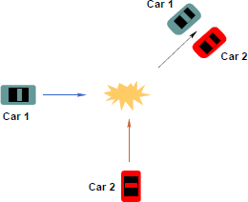

Angular collision-types
Angular collision of two vehicles resulting in movement in
resultant direction
After collision movement of car 1 north of west and car 2 in east of north

Slide 112


Angular collision-types
After collision movement of car 1 and car 2 in north of east
After collision movement of car 1 north of west and car 2 in east of north

Slide 113

Speed vs stopping distance
Figure Relationship of speed with breaking distance for a car on a dry road. Horizontal part of the line show the original cruising speed of the car and the curved part shows the breaking section. (Assume driver reaction time 1.8 s and average braking deceleration 5.8 m/s2)

Slide 114

Severity vs velocity

Slide 115
Topics of interest
Road safety audit
Traffic calming measures in urban areas Road safety improvement strategies
Accident prediction models: Zero inflated Poisson regression, Negative binomial, Safety performance functions (SPF) and Crash Modification Factors (CMF) and others

